Slide 1
FINAL PROJECT
221FA04117-P.Yesu babu
221FA04141-D.Raja gopal

Slide 2
Traffic-Aware Routing Optimization for High-Demand Network Environments
TITLE:-

Slide 3
ABSTRACT:
High-demand network environments such as smart transportation systems, data centers, and software-defined networks experience frequent congestion due to dynamic and unpredictable traffic patterns. Conventional static routing mechanisms are ineffective in handling such conditions, leading to increased delay, poor resource utilization, and degraded Quality of Service (QoS).The proposed methodology integrates traffic data collection, preprocessing, congestion analysis, traffic prediction, and dynamic routing optimization. Real-time and historical traffic data are analyzed to detect congestion-prone regions, while machine learning models including Linear Regression (LR), K-Nearest Neighbors (KNN), Multilayer Perceptron (MLP), and Long Short-Term Memory (LSTM) are employed to predict future traffic conditions. Based on both current and predicted traffic states, a dynamic weighted graph is constructed, and traffic-aware routing algorithms are applied to select optimal paths that minimize congestion and delay.

Slide 4
INTRODUCTION:
High-demand network environments often experience congestion due to rapidly changing traffic conditions, which leads to increased delay and poor Quality of Service. Traditional routing methods fail to adapt to dynamic traffic patterns. Traffic-aware routing overcomes this limitation by using real-time and historical traffic information to make intelligent routing decisions. In this project, machine learning models are used to predict traffic conditions, and routing paths are optimized accordingly. The proposed traffic-aware routing optimization approach aims to reduce congestion, minimize delay, and improve overall network performance.

Slide 5
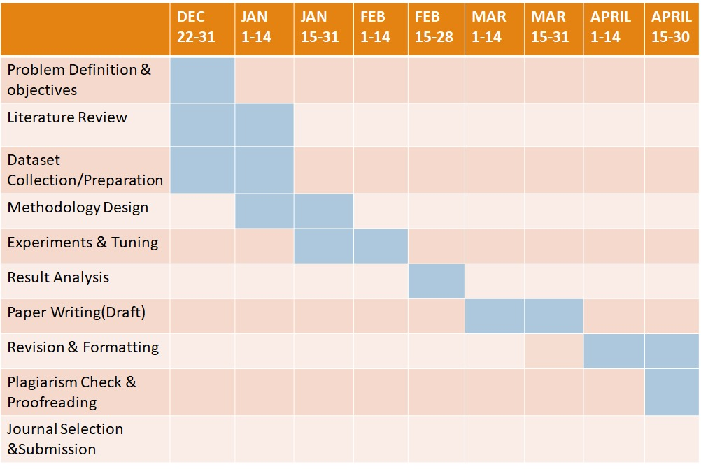
Gantt chart:

Slide 6
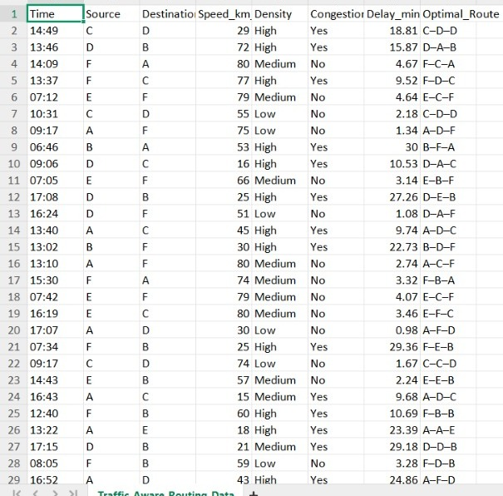
DATASET:

Slide 7
DATASET EXPLANATION:
Time: Time at which traffic conditions are recorded
Source: Starting node of the route in the network.
Destination: Ending node of the route in the network.
Speed_km_h: Average speed of vehicles on the route in kilometers per hour.
Density: Level of traffic on the route (Low, Medium, or High).
Congestion: Indicates whether the route is congested based on speed and density (Yes/No).
Delay_minutes: Time delay experienced on the route due to traffic conditions, measured in minutes.
Optimal_Route: Best selected path between source and destination that minimizes delay and congestion.

Slide 8
Dataset Preparation Process:
Problem Understanding: Defined traffic-aware routing requirements for high-demand networks.
Attribute Selection: Identified essential traffic, routing, and performance features.
Node Definition: Selected network nodes to represent source and destination point.
Time Generation: Created time-based records to capture peak and off-peak traffic.
Traffic Simulation: Generated realistic speed and density values.
Congestion Labeling: Determined congestion using speed and density thresholds.
Delay Assignment: Assigned delay in minutes based on congestion level.
Route Selection: Chose optimal routes minimizing congestion and delay.
Data Validation: Verified consistency and logical correctness of records.
Dataset Storage: Stored the finalized dataset in Excel format with 10,000 samples.

Slide 9
Why This Dataset Is Suitable?
It captures real-time traffic conditions such as speed, density, and congestion.
It represents high-demand network scenarios through varying traffic loads.
It includes delay information, which is essential for routing optimization.
It supports dynamic route selection using time-based data.
It can be directly used for traffic-aware routing and congestion analysis.
It is suitable for machine learning and optimization algorithms.

